Slide 1
AI-assisted Coding with Codeium
Presenters: Giulia Crocioni, Netherlands eScience center
Olga Minaeva, NWO-I

Slide 2
Workshop agenda
Introduction to AI in coding (30 min)
Codeium and VS Code setup (15 min)
Lunch break (60 min)
Code generation and optimization (75 min)
Command function and practical exercises
Chat function and practical exercises
Autocomplete function and practical exercises
Coffee break (15 min)
Ethical and security considerations (20 min)
Wrapping up and Q&A (10 min)

Slide 3



Main objectives:
Familiarize with the concept of AI coding assistants, available tools, and capabilities
Learn to generate code and optimize its performance using an AI coding assistant
Recognize, evaluate, and mitigate ethical and security considerations when using AI coding assistant

Slide 4
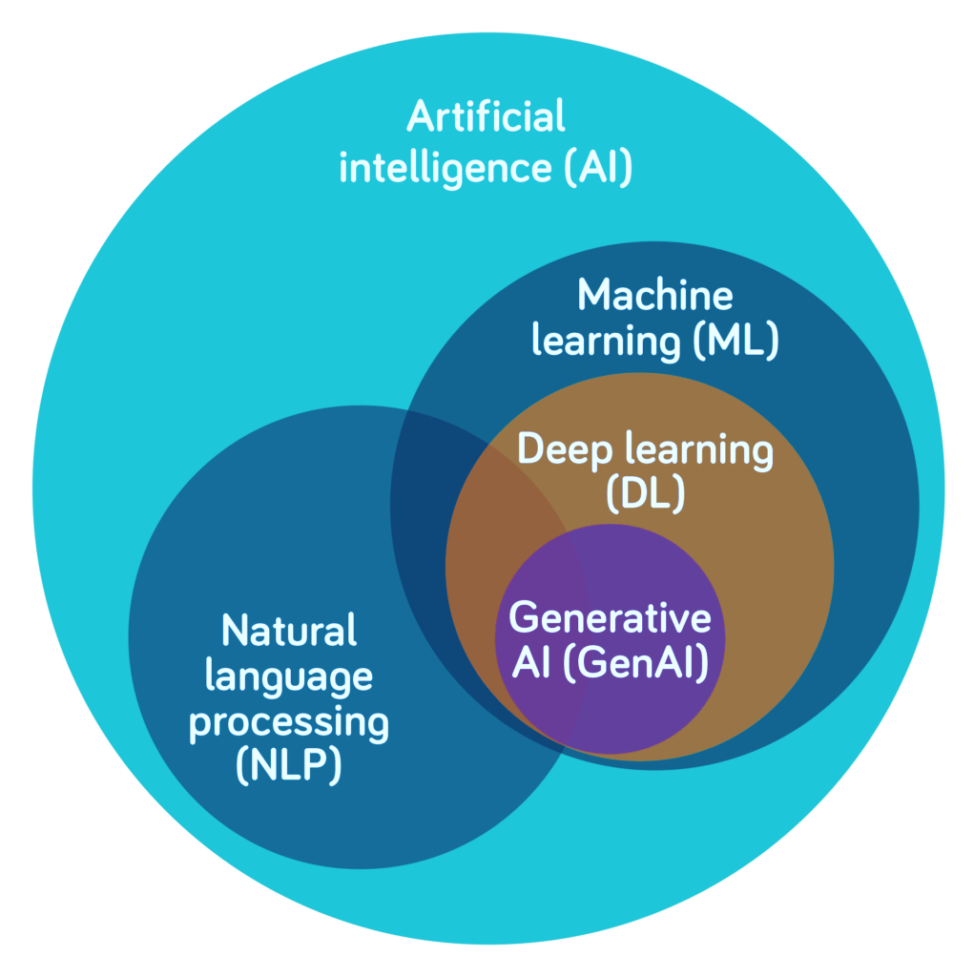
AI is a set of technologies that can reason and learn to solve problems or perform tasks that traditionally require human intelligence
ML uses algorithms trained on data to predict outcomes and perform specific tasks
DL, a subfield of ML, uses artificial neural networks to mimic the human brain
GenAI uses DL models to generate text, images, video or other media that mimic human-generated content
NLP enables computers to understand spoken and written language

Slide 5

AI coding assistants rely on ML techniques (deep learning and NLP)
Trained on public code and documentation to understand patterns, syntax, and code logic
Data collection
Gathering a large amount of code, documentation, and natural language conversations to train the Al model on.
Model architecture design
Designing the neural network architecture that will power the AI code assistant.
Pre-training the Al model on the collected data to develop a general understanding of code, programming concepts, and natural language.
Fine-tuning
Evaluation and iteration
Pre-training
Further training the pre-trained model on specific datasets and tasks related to code generation, code completion, and natural language programming.
Testing the AI code assistant on a variety of use cases, then iterating on the model architecture and training process to improve performance.

Slide 6
AI coding assistants rely on ML techniques (deep learning and NLP)
Trained on public code and documentation to understand patterns, syntax, and code logic
Context awareness to suggest relevant code
NLP to interpret natural language
Learning from user interaction
Code generation and refactoring
Multilanguage support

Slide 7
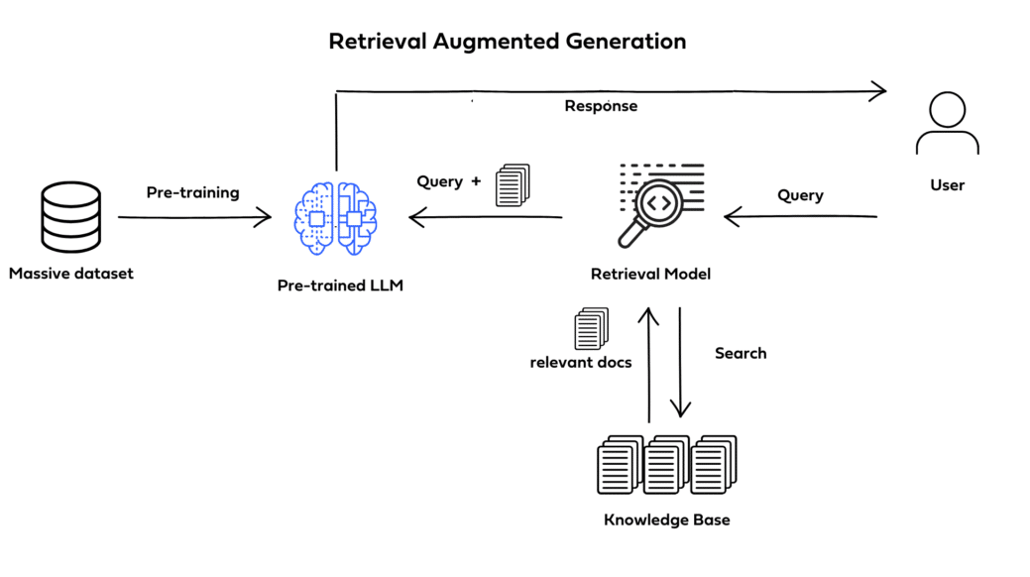
Context Awareness - Retrieval-Augmented-Generation
Augments LLMs with external knowledge
→ more factual consistency, improves reliability, and prevents "hallucination"
Useful in domain-specific applications
RAG can be fine-tuned without retraining of the entire model
Notes:
Augments LLMs with external knowledge such as databases.
→ more factual consistency, improves reliability of the generated responses, and helps to prevent "hallucination"
Particularly useful in domain-specific applications that require knowledge that's continually updating.
RAG can be fine-tuned and its internal knowledge can be modified without retraining of the entire model

Slide 8
Areas of application
Intelligent code completion
Reducing the time spent on routine typing tasks
Real-time error detection
Allows to fix issues before execution, enhancing code reliability
Code refactoring suggestions
Analyze existing code and propose optimizations
Automated documentation generation
Can generate documentation snippets based on the code, reducing manual effort
Code and error explanation
Collaboration enhancement
Version control integration and shared code analysis promote teamwork
Can explain code functions or errors in code and help fix them
Notes:
Intelligent Code Completion:
Al-powered code editors offer advanced suggestions to complete code snippets, reducing the time developers spend on routine typing tasks.
Context-aware completions improve accuracy by considering variable names, function calls, and relevant syntax patterns.
2. Real-time Error Detection:
Immediate identification of syntax errors and potential bugs allows developers to rectify issues before execution, enhancing code reliability.
3. Code Refactoring Suggestions:
Al algorithms analyze existing code and propose optimizations, suggesting improvements in terms of readability, efficiency, and adherence to coding standards.
Automated refactoring assists developers in maintaining clean and maintainable codebases.
4. Automated Documentation Generation:
Al-powered code editors can generate documentation snippets based on the code, reducing the manual effort required for documentation.
Ensures that code changes are consistently documented, promoting better collaboration and knowledge sharing.
5. Collaboration Enhancement:
Features such as version control integration and shared code analysis promote seamless teamwork.

Slide 9
Small-scale Tasks - Simple Automation, with a focus on accelerating individual coding steps.
Mid-scale Tasks - Intelligent Code Synthesis, indicating a stronger understanding of context.
Large-scale Tasks - Modular Development, showing how AI helps manage and integrate project components.
Future Capabilities - Project-Level Insights, suggesting strategic capabilities in project architecture and planning.
Code autocompletions, syntax suggestions, code snippets, and basic refactoring.
Larger code generation (e.g., function or class templates), testing code, debugging assistance, and minor performance optimizations.
Context-aware refactoring, multi-component code generation (e.g., module or API structures), advanced debugging, and performance tuning.
Encompassing full project scaffolding, contextually-aware adjustments across codebases, and strategic project optimizations.

Slide 10

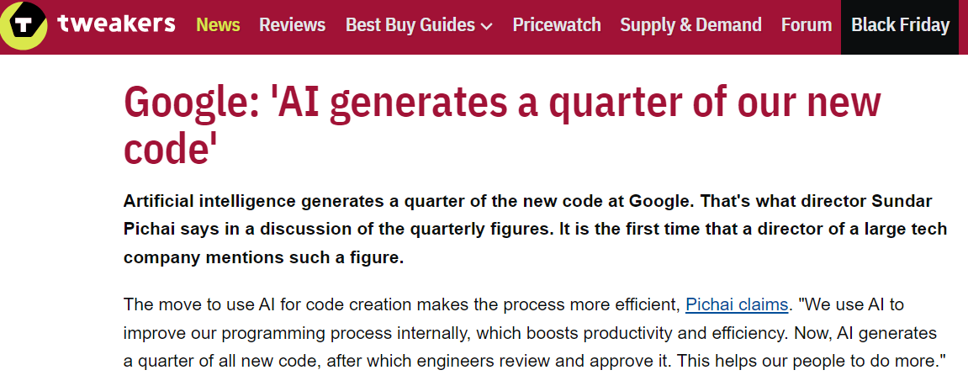
https://tweakers.net/nieuws/228140/google-ai-genereert-kwart-van-onze-nieuwe-code.html

Slide 11
Challenges
Balancing accuracy and speed
Adaptability to different coding styles
Ensuring user privacy and security
Limited context awareness
Unclear Al behavior
Notes:
1. Balancing Accuracy and Speed:
Striking a balance between providing accurate suggestions and maintaining a responsive user interface is a key challenge.
3. Adaptability to Different Coding Styles:
A. Developers often have varied coding styles and preferences. Al-powered code editors need to adapt to these differences to provide personalized and effective assistance.
4. Ensuring User Privacy and Security:
A. Handling sensitive code and ensuring the privacy of proprietary algorithms pose significant challenges.
5. Limited Context Awareness:
B. Inability to understand the intent and purpose behind code can result in irrelevant or unhelpful completions.
3. Opaque Al Behavior:
A. Many editors lack transparency in how Al works, leaving developers unsure of the rationale behind suggestions or potential biases in the models.
B. This lack of explainability can hinder trust and acceptance of Al assistance.

Slide 12





 | GitHub Copilot | Codeium | Amazon Q Developer | Tabnine | Hugging Chat
Key Features | Integration with GitHub ecosystem Code completion and context-aware suggestions | Advanced code completions Code refactoring capabilities | Code recommendations Security scans for vulnerabilities | Robust autocompletion AI-powered chat using multiple models | Open-source model integration High flexibility in deployment
Supported languages | ~40 (primarily Python, Ruby, JS, C#) | 70+ languages, including Python, R, Ruby, HTML, Java, C#, SQL | 18+ languages, including Python, Java, JS, C# | 25+ languages | Various languages, including Python and Java
Security | Processes code snippets locally, code remains private and secure | Never train generative model on private code | Doesn't use customer content for service improvement | Never train generative model on private code | Private repositories, access tokens, commit signatures, malware scanning
Pricing | Both free and paid versions | Both free and paid versions | Both free and paid versions | Both free and paid versions | Both free and paid versions

Slide 13
Using Codeium as a Coding Assistant
Command
Autocomplete
Chat
Notes:
Command: With Command, you can tell Codeium what changes you want to make to your code in plain language. Codeium will then suggest the changes, which you can choose to accept, reject, or adjust as needed.
Chat: This feature allows you to ask questions and get answers using simple, everyday language. You can access Chat from the side panel in your coding tool. It’s great for when you’re working with new or unfamiliar code and need quick guidance or explanations.
Autocomplete: This feature is always working in the background of your coding tool (IDE). It gives suggestions as you type, shown in light gray text. Autocomplete is most helpful when you already have a rough idea of what you want to code and just need to finish it quickly. It helps you stay focused and keeps your work flowing smoothly.

Slide 14

Break

Slide 15

Three modes/models
Command
To generate new code or edit existing code via natural language inputs, directly in the editor window
Chat
To talk to your codebase from within your editor
Autocomplete
To make in-line and multi-line suggestions based on the context of your code
Generated with Imagen3 by Google DeepMind
Notes:
Codeium accelerates software development through three key modes: Command, Chat, and Autocomplete. Each mode leverages Codeium’s real-time context awareness engine to deliver highly relevant and useful suggestions.

Slide 16
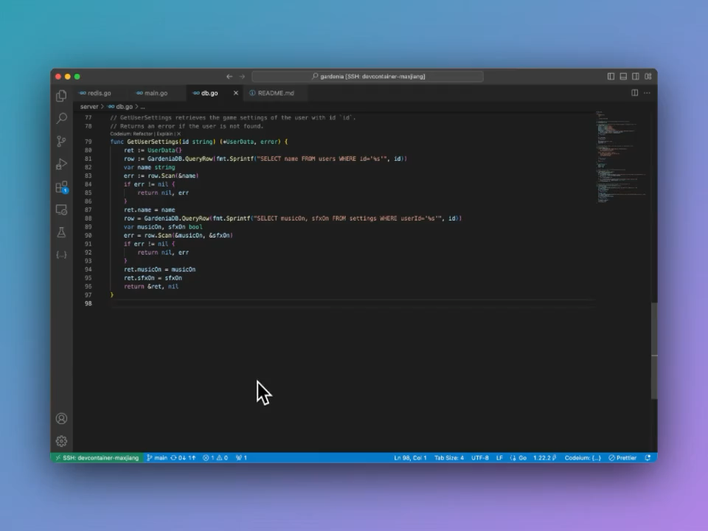
Command
Enter a Prompt
MacOS: ⌘+I
Win/Linux: ctrl+I
Accept suggestion
MacOS: ⌥+A
Win/Linux: Alt+A
Reject suggestion
MacOS: ⌥+F
Win/Linux: Alt+F
Notes:
Sometimes it can be easier to describe the what we want to code in natural language, especially when writing simple pieces of code. In this episode, we will learn to use the Command feature of Codeium, which allows you to generate or modify code simply by using natural language inputs. Instead of manually coding everything, you can describe what you want in plain English, and Codeium will help you do it — whether it’s creating new functions or refactoring existing pieces of code.
By pressing command+I on Mac or Ctrl+I on Windows/Linux, you can enter a prompt and receive code suggestions, making it easier and faster to develop code directly within your editor.
Codeium will then provide a multiline suggestion that you can accept or reject. You can accept a suggestion by pressing Option+A on Mac or Alt+A on Windows/Linux, reject (Option+R on mac or Alt+R on Windows/Linux), or follow-up a generation (Option+F on Mac or Alt+F on Windows/Linux) by using the appropriate shortcuts or by clicking the corresponding code lens above the generated diff.
If you highlight a section of code before invoking Command, then the AI will edit the selection spanned by the highlighted lines. Otherwise, it will generate code at your cursor’s location.

Slide 17
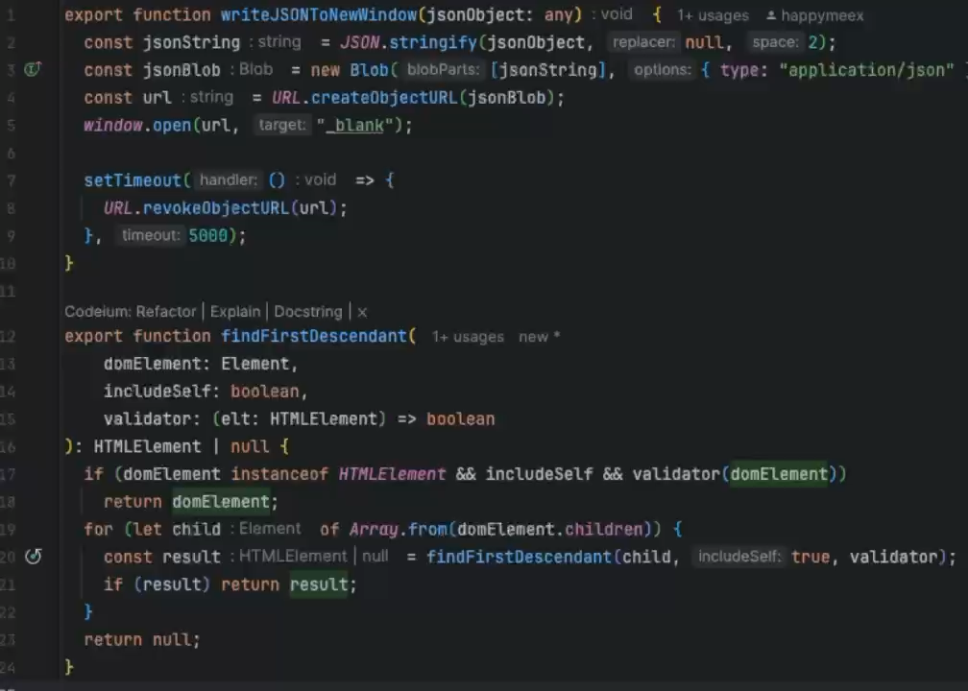
Command – Refactoring&Docstrings
Code lenses
Refactor functionality
Docstring Generation
Notes:
In Codeium, code lenses appear right above your function and class definitions, providing convenient shortcuts for common tasks. These clickable labels allow you to quickly generate docstrings, explain code, or refactor code with just a click, saving time on manual edits. These features are powered by Command, which uses natural language inputs to assist with tasks like improving code structure and generating documentation.
Codeium’s Command feature enhances your coding workflow by offering specific functions through code lenses.
Refactor Functionality: Clicking the Refactor label triggers Codeium’s refactoring capabilities, providing a dropdown of pre-filled options or allowing you to write a custom instruction. This is particularly useful for improving performance or restructuring code. You can also highlight a block of code and use Command (command+I or Ctrl+I) to perform more targeted refactoring.
Docstring Generation: For generating documentation, clicking the Docstring label automatically creates a docstring above your function header (or under the function header in Python). This AI-generated documentation will describe what the function does, helping you maintain well-documented, readable code.

Slide 18

Command – Best practices
Advanced model behind Command
Highlight a specific piece of code before using Command
Give clear and detailed prompts
E.g., Write a function that takes two inputs of type Diffable and implements the Myers diff algorithm
Always review AI-generated code
Icon taken from https://www.flaticon.com/
Notes:
Here are a few things to remember when using Command function of Codeium:
The model behind Command is more advanced than the one used for autocomplete, making it slower but more capable of following complex instructions.
To edit a specific selection of code, highlight that piece of code before using Command. If not, it will generate new code at the cursor’s position.
For effective use, try to give clear and detailed prompts. While simple requests like “Fix this” or “Refactor” can work well due to context awareness, more specific instructions like “Write a function that takes two inputs of type Diffable and implements the Myers diff algorithm” can yield even better results.
Always review AI-generated code to ensure they accurately reflect the purpose and parameters of the function.

Slide 19
Assisted Code Generation – Part 1
In this exercise, you will use the Command mode to load a CO2 concentration dataset from the file co2-mm-mlo.csv into a Pandas DataFrame, then generate descriptive statistics and visualize data distributions. Link: https://datahub.io/core/co2-ppm
Write a function that takes a DataFrame as input and calculates key descriptive statistics, including:
Number of rows and columns
Data types of each column
Summary statistics (e.g., mean, minimum, maximum) for numeric columns
Write a function that accepts a DataFrame and a specific column as inputs. If the column is numeric (e.g., int64, float64), create a histogram to display its distribution; if categorical, create a bar plot to show category frequencies.
Write a function to plot the Average and Interpolated columns on a single graph, with Date on the x-axis, to visualize their distributions over time.

Slide 20
Docstring Generation
Modify the calculate_descriptive_stats() and visualize_column_distribution() functions you created during the previous exercise to add a detailed docstring using Codeium’s Docstring lens. Each docstring should:
Describe the purpose of the function
Document the function’s arguments and expected data types
Explain what the function returns (if applicable)
Optionally, provide a usage example
Please note that, while you could manually write the docstring and use suggestions from Autocomplete mode (which we will cover later in this episode), this task is designed to demonstrate Codeium’s Docstring functionality.

Slide 21
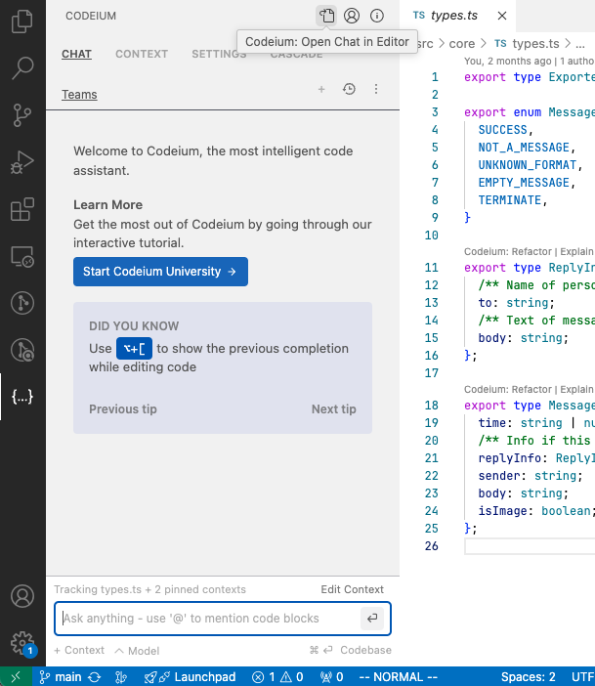
Chat
Similar to the Command function
Chat with the AI assistant
Get instant feedback
Interact
By default on the left sidebar
Open the chat panel
MacOS: ⌘+⇧+A
Win/Linux: ctrl+⇧+A
Notes:
The Codeium Chat feature offers a powerful way to interact with an AI assistant directly within your coding environment, providing instant, contextual feedback on your code. Unlike the Command function, Codeium Chat is designed for a more conversational and responsive interaction, making it easy to discuss complex coding questions and solutions.
In Visual Studio Code, you can access Codeium Chat by clicking on the Codeium icon located in the left sidebar by default.
To quickly open the chat panel or toggle focus between it and your code editor, use command+shift+A on Mac or Ctrl+shift+A on Windows/Linux. For a more flexible experience, you can pop the chat panel out of the IDE entirely by clicking the “pop-out” icon at the top of the chat window.

Slide 22
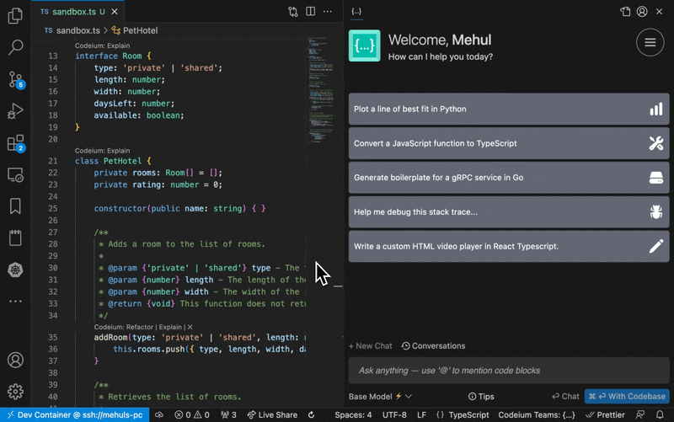
Chat – @mentions
To refer to context items within the chat input
Function names
Class names
Directories
Files
Terminal history
[…]
Notes:
In any chat message, you can use the @mentions feature to refer to context items from within the chat input by prefixing a word with @. Context items can be function names, class names, directories and files, or even content of your termnal history. By doing this explicitly, Codeium will make the most relevant suggestions for you.

Slide 23
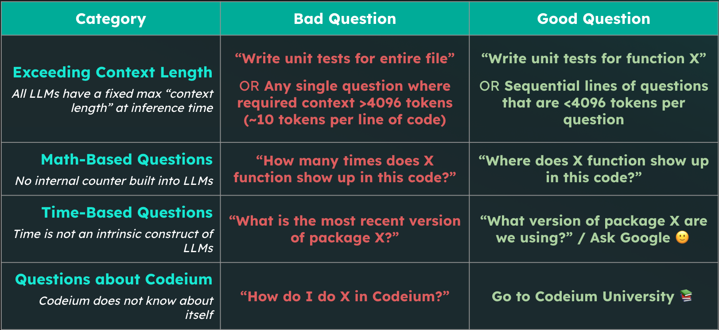
Chat – Prompting
Notes:
Clear and efficient prompting is a vital element of both Chat and Command features. There are three key components to a good prompt
Clear Objective: Be specific about what you want Chat to produce—whether it’s new code, a refactor, or an explanation.
Contextual Details: Use @ mentions to provide context, such as referring to specific functions, classes, or modules.
Constraints: If there are specific requirements, such as using certain frameworks or considering performance, include these in your prompt.

Slide 24
Assisted Code Generation – Part 2
Look back at the previous “Assisted Code Generation, Part 1” exercise and consider the code generated by Codeium. If you look at the head of the DataFrame, what do you notice?
Use the Chat feature to discuss the issue with Codeium and ask for suggestions on how to resolve it. Then run again the functions defined in the previous exercise to see if the issue has been resolved.

Slide 25
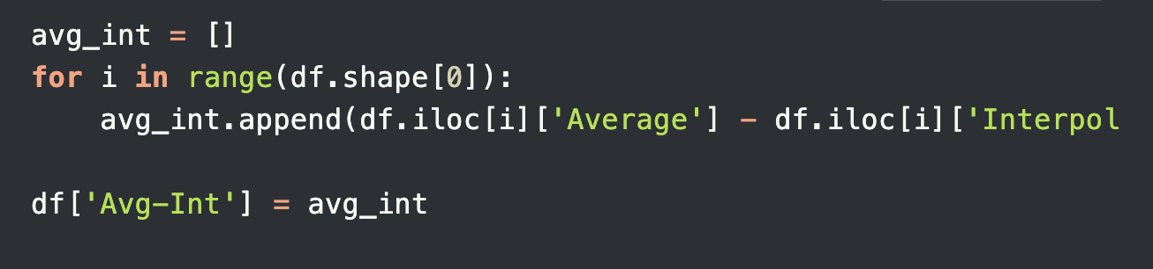
Optimization of the code
Given the following piece of code that processes the previously read the dataset to find the difference between the average and interpolated CO2 concentration for each row:
Use the Command or Chat feature to optimize this code for better performance and readability. Consider using vectorized operations or other pandas functions to achieve this.

Slide 26
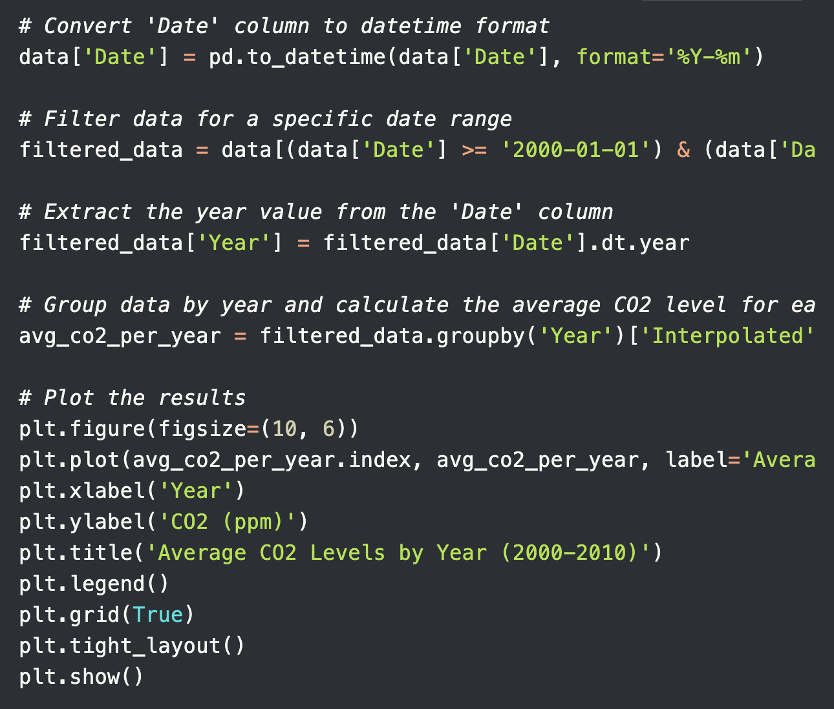
Optimization of the code - 2
Similar to the exercise above, execute the code as is to verify it works and examine the output. Then use Codeium’s Chat feature to analyze and suggest potential improvements. Look for ways to enhance performance, readability, and conciseness.

Slide 27

Autocomplete
Boilerplate code
Repetitive functions
Code formatting and styling
Notes:
A key feature of Codeium is its Autocomplete function: with every keystroke, Codeium actively attempts to predict and complete what you’re typing. By analyzing the current file, previous edits, and contextual snippets from your codebase, it offers relevant suggestions as “ghost text”.
This feature can be particularly useful when you’re writing boilerplate code (which refers to repetitive code that often serves as a standard template), as it can save you time and reduce the likelihood of errors. By leveraging Codeium’s Autocomplete function, you can speed up your coding process and focus on the more creative and challenging aspects of your work.
By recognizing patterns in your codebase, Codeium can predict and suggest repetitive structures such as:
Boilerplate code: Generate routine code structures like class definitions, function signatures, or common initialization blocks with minimal effort.
Repetitive functions: Quickly replicate commonly used functions or methods that follow a similar pattern, reducing the need for retyping or copy-pasting.
Code formatting and styling: Maintain consistency in your code format by allowing Codeium to suggest and automate repetitive formatting tasks, saving you from manual corrections.

Slide 28
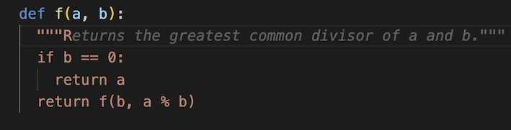
Autocomplete
Fill-in-the-middle (FIM)
Inline comments
Notes:
Codeium’s Autocomplete model also includes Fill-in-the-Middle (FIM) capabilities. This is crucial because, more often than not, you’re inserting code within an existing file, rather than just appending new lines. With FIM, Autocomplete analyzes the code both above and below the current line to provide more accurate suggestions.
You can guide the Autocomplete feature by using comments within your code. Codeium interprets these comments and generates code suggestions to implement what the comment describes.

Slide 29
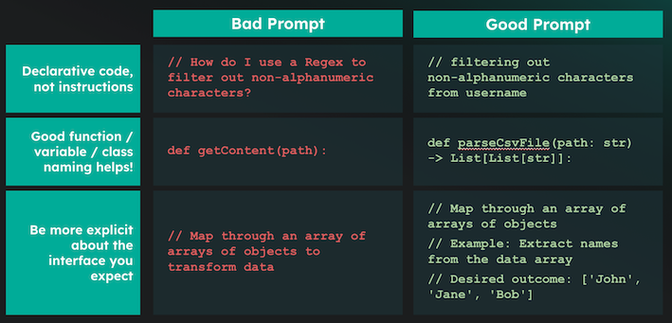
Autocomplete – Best practices
Notes:
Avoid manually triggering Autocomplete; instead, let it naturally enhance your workflow. Writing prompts as comments is not recommended, but decorating your code with quality comments and information variable/function names yields the best results.
To achieve the best results with Autocomplete, it’s important to enhance your code with clear, declarative (not instructive) code, descriptive function names, and good comments with examples of the desired inputs and outputs. See the table below for examples:

Slide 30
Autocomplete exploration
Use Codeium’s Autocomplete to assist in writing Python code that analyzes seasonal trends and interpolates missing values in the dataset you loaded earlier. Considering the dataset previously loaded into a Pandas DataFrame, pretending that you have only Date, Decimal Date, and Average columns, follow these instructions:
Prompt Codeium to suggest code that will plot the Date versus Average values to visualize the seasonal trends over time. Use Autocomplete to adjust the plot (e.g., adding labels, legends, or gridlines) for better readability.
Use linear or time-based interpolation and plot the Interpolated column over Date to confirm the method worked as expected.
Use Autocomplete to write code that calculates the moving average or seasonal trend, potentially using the Trend column. Plot the calculated trend alongside the Average and Interpolated values to observe any patterns.

Slide 31
Break

Slide 32
AI coding assistant ethics challenge (15 min)
List at least two potential risks or vulnerabilities that could arise from using an AI coding assistant in this project.
For each risk identified, propose a specific mitigation strategy. Explain how this strategy addresses the risk and aligns with the best practices discussed in the lesson.
Draft a set of at least 5 ethical guidelines for your team to follow when using the AI coding assistant. These should cover areas such as bias prevention, code review processes, and data privacy.
Outline a security protocol that includes at least three specific measures to protect sensitive data and ensure the integrity of the AI-assisted development process.
Design a collaborative code review process that leverages the strengths of both human developers and the AI assistant while mitigating potential risks.
Notes:
You’re leading a team that’s considering adopting an AI coding assistant for a new project involving sensitive user data. Your task is to create a comprehensive plan that addresses the ethical and security concerns discussed in the lesson.

Slide 33
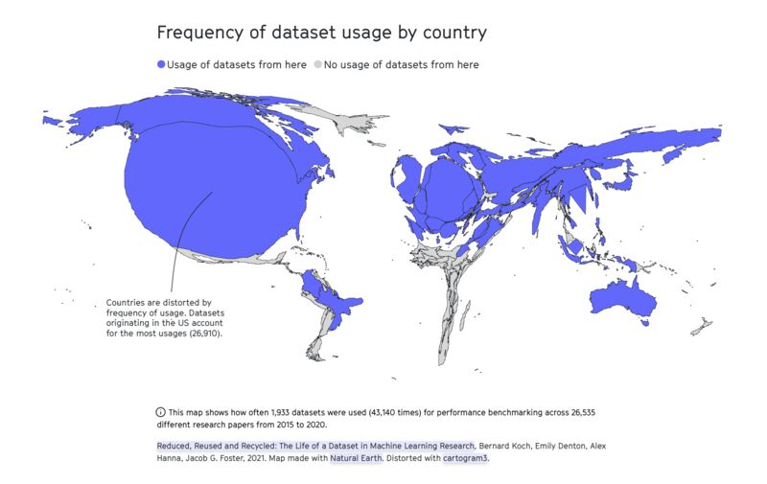
Ethical and data security considerations
AI-generated content is based on human choices, values, and flaws
Lack of diversity in training data

Slide 34
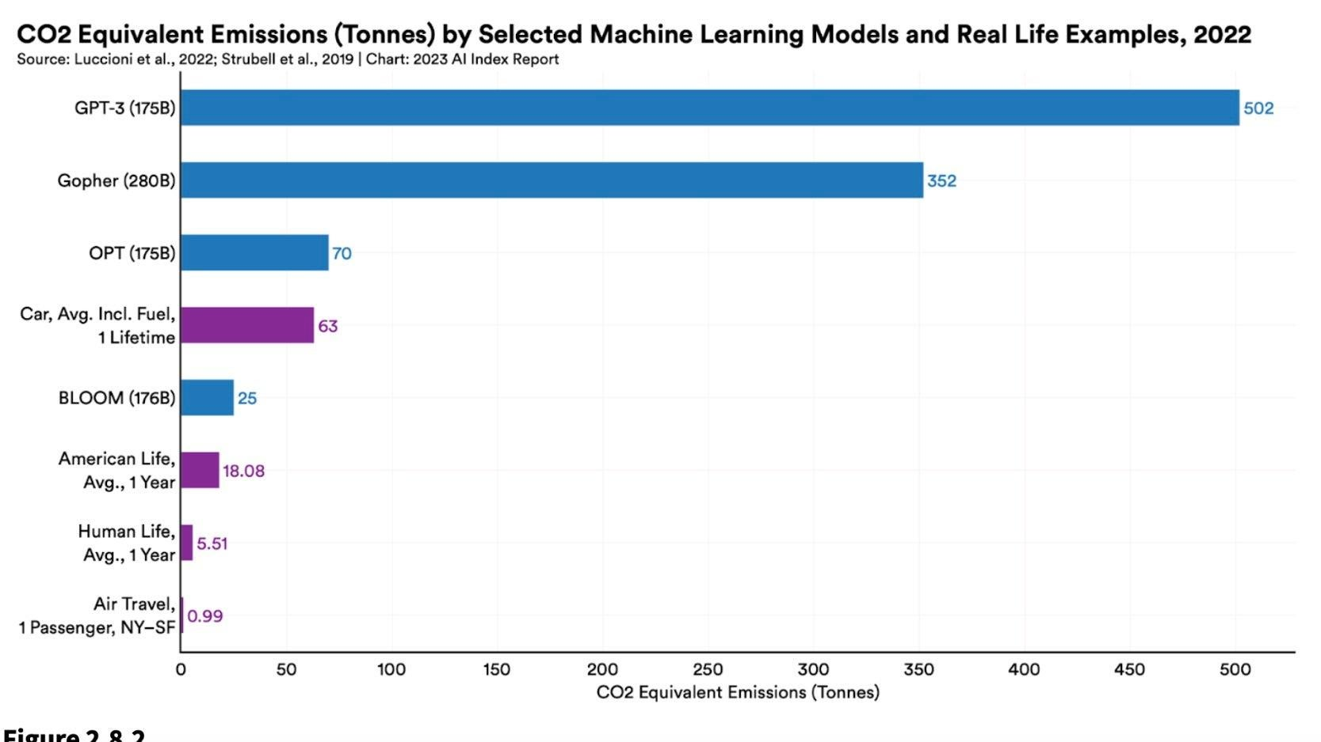
Ethical and data security considerations
Environmental costs of GenAI (energy and water use)
by 2027, the annual electricity usage of AI servers could equal the annual electricity usage of the Netherlands or Sweden.¹
LLM could use up to 500 ml of water per 5-50 prompts.²
Screenshot: “The AI Index 2023 Annual Report,” AI Index Steering Committee, Institute for Human-Centered AI, Stanford University, Stanford, CA
1. https://www.nytimes.com/2023/10/10/climate/ai-could-soon-need-as-much-electricity-as-an-entire-country.html
2. https://fortune.com/2023/09/09/ai-chatgpt-usage-fuels-spike-in-microsoft-water-consumption/?utm_source=www.joinsuperhuman.ai&utm_medium=newsletter&utm_campaign=ai-needs-a-lot-of-water

Slide 35
Ethical considerations
Exploitative labor to train GenAI models¹
'reinforcement learning through human feedback’ outsourced to low-wage employees in Kenya
Unequal accessibility
cost of tools is a barrier
the use of particular GenAI tools may be restricted due to government regulation or censorship
1. https://time.com/6247678/openai-chatgpt-kenya-workers/

Slide 36
Best practices for ethical use of AI assistants
Vigilant evaluation of results to identify and reduce potential biases
Transparency and accountability in AI use
Acknowledge and cite AI-generated output in your work
Following clear AI guidelines

Slide 37
Current AI regulations in the EU
Risk Categories
The AI Act (August 2024)
Purpose: Ensures AI is safe, respects fundamental rights, and supports democracy, the rule of law, and environmental standards.
Applies to public & private sectors within and outside the EU if AI impacts people in the EU.
Exemptions: Research, military/defense, and non-market prototypes.
Unacceptable Risk: Banned uses (e.g., social scoring, exploitative manipulation).
High-Risk: Systems impacting rights and safety (e.g., job screening, law enforcement).
Transparency Risk: Disclosures required for manipulation-prone applications.
Minimal Risk: General use with voluntary standards adherence.
Notes:
The AI Act (proposed in December 2023, approved on March 18
Purpose: Ensures AI is safe, respects fundamental rights, and supports democracy, the rule of law, and environmental standards.
Benefits & Risks: AI brings societal and economic benefits but also new safety and rights-related risks that could impact trust.
Applicability
Applies to public & private sectors within and outside the EU if AI impacts people in the EU.
Exemptions: Research, military/defense, and non-market prototypes.
Risk Categories
Unacceptable Risk: Banned uses (e.g., social scoring, exploitative manipulation).
High-Risk: Systems impacting rights and safety (e.g., job screening, law enforcement).
Transparency Risk: Disclosures required for manipulation-prone applications.
Minimal Risk: General use with voluntary standards adherence.
Compliance
High-Risk Obligations: Conformity assessments, data quality, transparency, cybersecurity.
Systemic Risks: Rules for general-purpose AI, including labeling requirements for generative outputs.
, 2024)

Slide 38

Current AI regulations in the EU
Living guidelines on the responsible use of generative AI in research by the European Commission (March 2024)
Researchers:
Responsibility for scientific output
Transparent GAI use
Privacy, confidentiality, and intellectual property rights
Legal and ethical standards
Refrain from using GAI substantially in sensitive activities

Slide 39
Current AI regulations in the EU
Living guidelines on the responsible use of generative AI in research by the European Commission (March 2024)
Research Organizations:
Monitor and evaluate the development and use of GAI systems
Reference or integrate GAI guidelines into general research guidelines
Implement local or cloud-based GAI tools with adequate data protection measures
Promote, guide, and support the responsible use of GAI

Slide 40
Data security
Random and systematic errors can undermine reliability
GitHub Copilot generated correct code only 46.3 percent of the time
Intellectual property issues
Do not enter copyrighted materials
Blurred boundaries of authorship and ownership → no clear-cut answers
Code review processes to evaluate AI-generated code for potential vulnerabilities and errors.

Slide 41
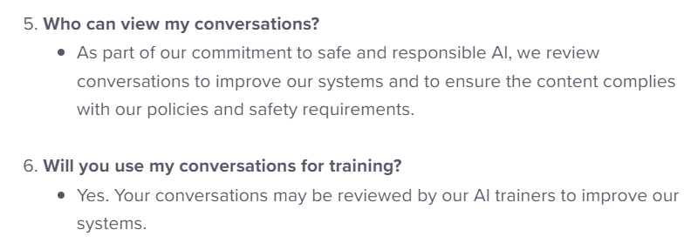
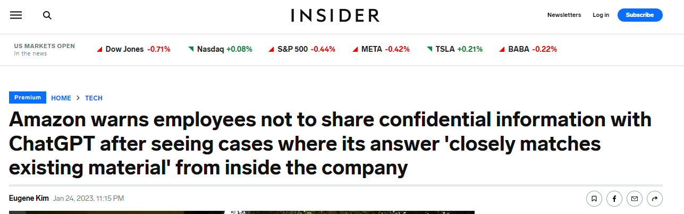
Data security
Dealing with sensitive research and personal data
your input will probably be used to further train the GenAI tools
data is processed and stored on US servers
Use offline AI tools
For projects involving proprietary or sensitive data
TabNine can be run locally without the need for Internet access
Training a LLaMA model locally, which allows for a customized coding assistant
https://help.openai.com/en/articles/6783457-chatgpt-general-faq
https://businessinsider.com/amazon-chatgpt-openai-warns-employees-not-share-confidential-information-microsoft-2023-1

Slide 42
Security measures
Access controls and data encryption to protect sensitive code bases
Prevents unauthorized access → reducing the risk of data breaches or malicious tampering.
Continuous monitoring and updates
Automate updates and ensure that the latest security practices are consistently applied → minimize the introduction of vulnerabilities
Collaborative Oversight
Regular code reviews can promote collective responsibility, enhancing code quality through diverse perspectives
Notes:
Collaborative Oversight
Multiple perspectives help identify potential flaws that an individual developer might overlook. Implementing regular code reviews can foster an environment of collective responsibility, enhancing code quality through diverse perspectives.

Slide 43
Key takeaways
Code generation and optimization using Chat, Command, and Autocomplete functions of Codeium
Follow best practices (e.g., always review generated code) and be cautious with sensitive data
Be aware of potential biases in AI-generated code and ensure ethical coding practices
Use AI as a tool to augment, not replace, your coding skills!
What are your questions?

Slide 44
Workshop feedback
Survey: here will be a QR code to a feedback form

Slide 45



Giulia Crocioni g.crocioni@esciencecenter.nl
The end!
Thanks
Olga Minaeva
o.minaeva@nwo-i.nl

